Slide 1
Project Management System
GROUP - 5
Team Members:
Anupam Sinha (M2021ANLT005)
Gaurav Minz (M2021ANLT011)
Rohit Suman (M2021ANLT027)
Satya Prakash (M2021ANLT030)

Slide 2


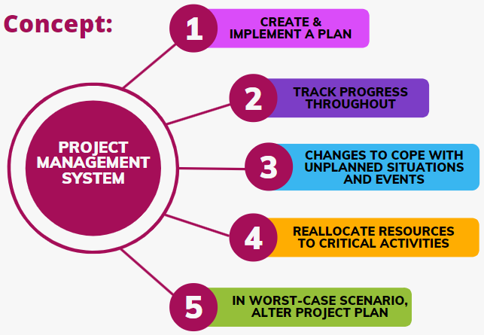

Idea of the project:
In a perfect world, we could deliver project results on time, on budget and with the right quality. In real life, we need to balance scheduling, budgeting and quality during the entire process.
Our data model consists of three main subject areas:
Company Details - Email Id, Contact No, Department
Project Details - Project Category, Project Managers & its details.
Project Activities - Project tasks, Project members & Project updates

Slide 3
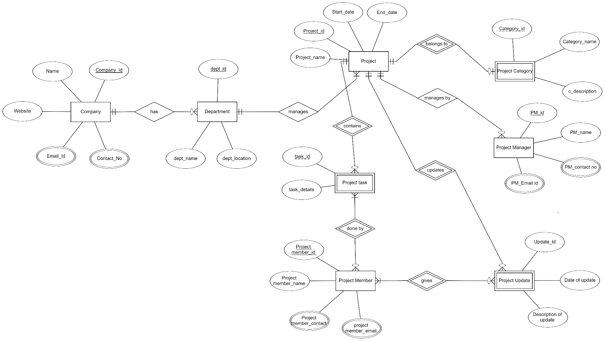
ER-Diagram in ERDPlus tool.

Slide 4
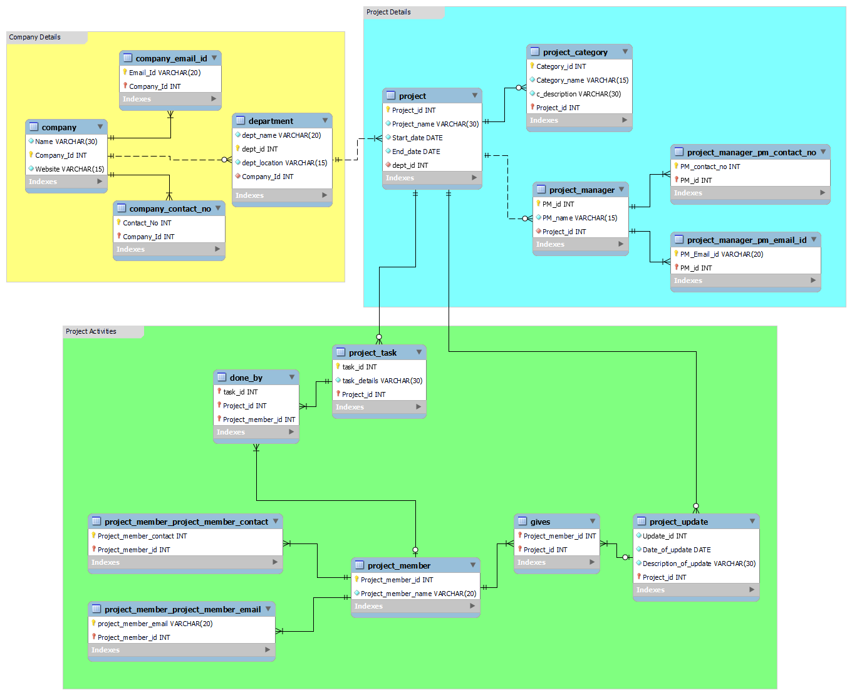
Model in MySql Workbench.

Slide 5
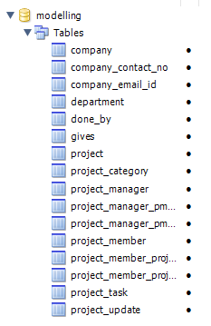
Demonstrate forward & reverse engineering in MySQL Workbench :
Forward Engineering: A visual data model can be transformed into a physical database on a target MySQL Server by executing the forward engineering wizard.

Slide 6
Demonstrate forward & reverse engineering in MySQL Workbench :
Reverse Engineering: The process of transformation of various logical schemas into diagram on canvas of MySQL workbench based upon the source code which we had taken from relational schema of ER diagram from ERD Plus tool.

Slide 7
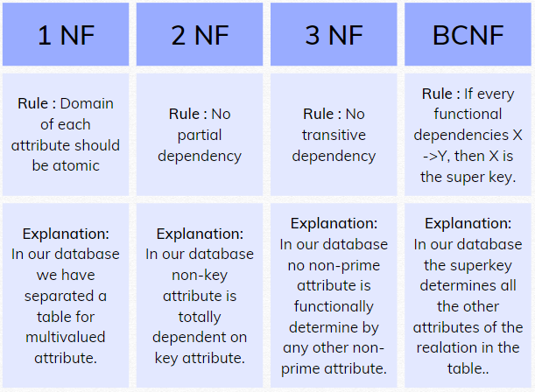
Checking for Normalization:
Our database is normalized as it follows all the normal forms i.e. 1NF, 2NF, 3NF & BCNF.
Explanations are as follows:

Slide 8
THANK YOU!!

